Slide 1
A FREIGHT GROWTH FORECAST
Transport – the next 50 years
Christchurch July 2007
Hon Tony Friedlander
CEO, RTFNZ

Slide 2
Freight growth impacts on:
  Infrastructure planning
  Industrial planning
  Transport planning
  Community planning
Major information gap
Policy made in a vacuum
RTFNZ retained Transport Engineering Research New Zealand Limited

Slide 3
Methodology
  Past HMV km travelled and HMV RUC payments
  Relationship between GDP growth and HMV km travelled and HMV RUC payments
  Project ratios forward:
    Freight growth 2005 to 2020
    Regional freight growth
  Cross check with commodity groups

Slide 4
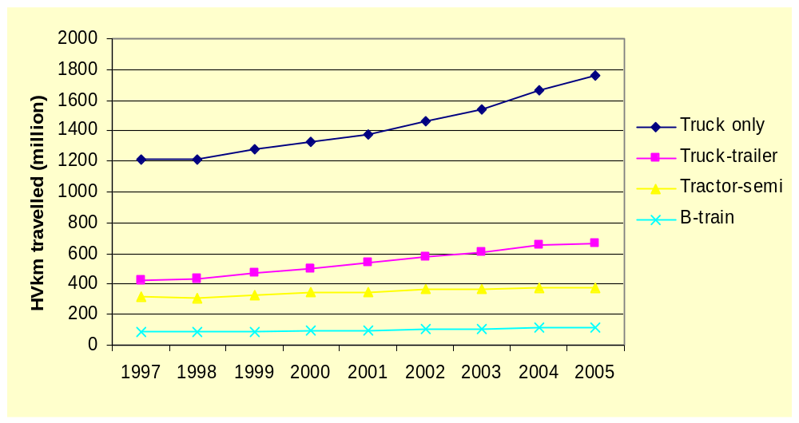
Growth in distance travelled by heavy vehicle combinations between 1997 and 2005
(Source: TERNZ)

Slide 5
Between 1997 and 2005
  42% increase in HMV travel
  HMV RUC increased 9% faster than HMV travel
  29% increase in GDP
Relationships between GDP growth and HMV travel 1:1.42
Relationship between GDP growth and HMV RUC payments 1:1.51

Slide 6
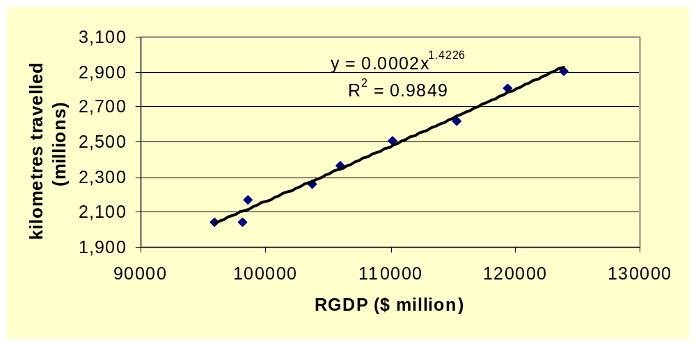
Heavy vehicle kilometres travelled vs Real Gross Domestic Product 1997-2005
(Source: TERNZ)

Slide 7
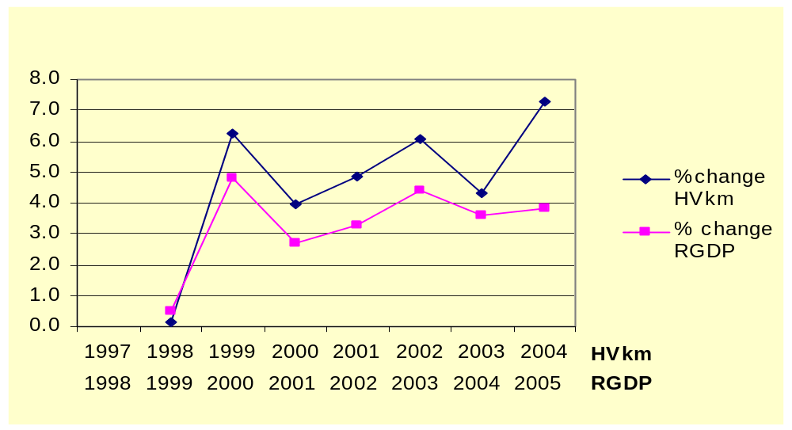
Percentage change in heavy vehicle travel and RGDP, with RGDP moved back by one year
(Source: TERNZ)

Slide 8
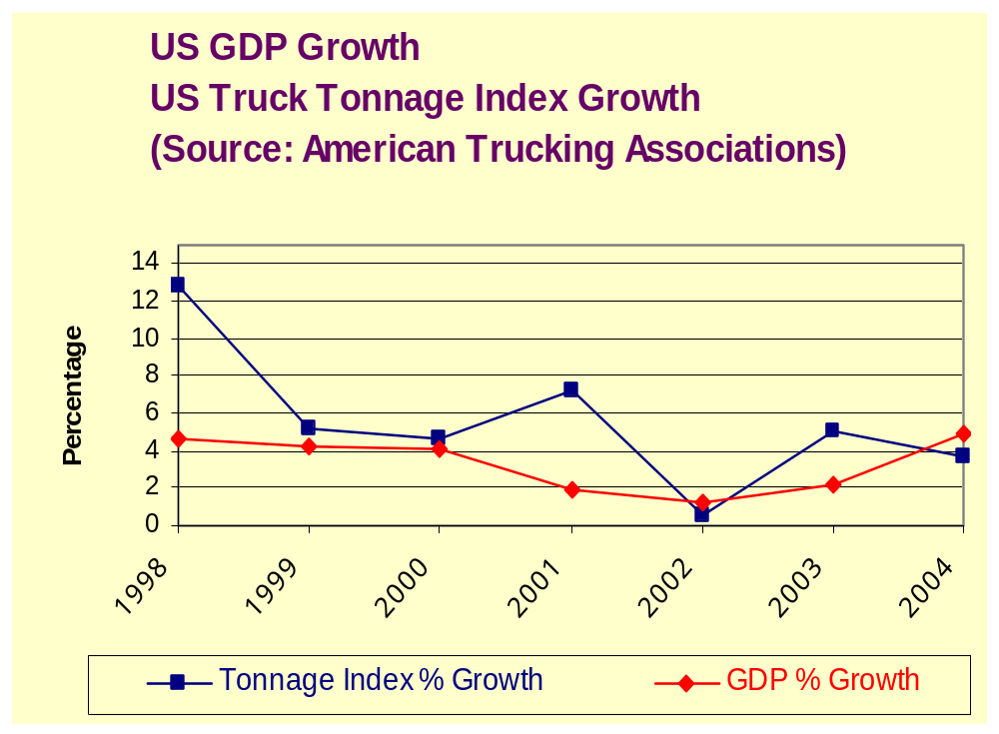

Slide 9
Treasury GDP growth forecasts:
  2006 2.2%
  2007 2.6%
  2008 3.5%
  2009 3.1%
No Treasury forecasts after 2009:
  Average 1995-2005 3.5%
  Alternative 2.5%

Slide 10
Forecast freight growth using HMV travel model:
  72% using 2.5% GDP
  100% using 3.5% GDP
Forecast freight growth using HMV RUC model:
  78% using 2.5% GDP
  109% using 3.5% GDP

Slide 11
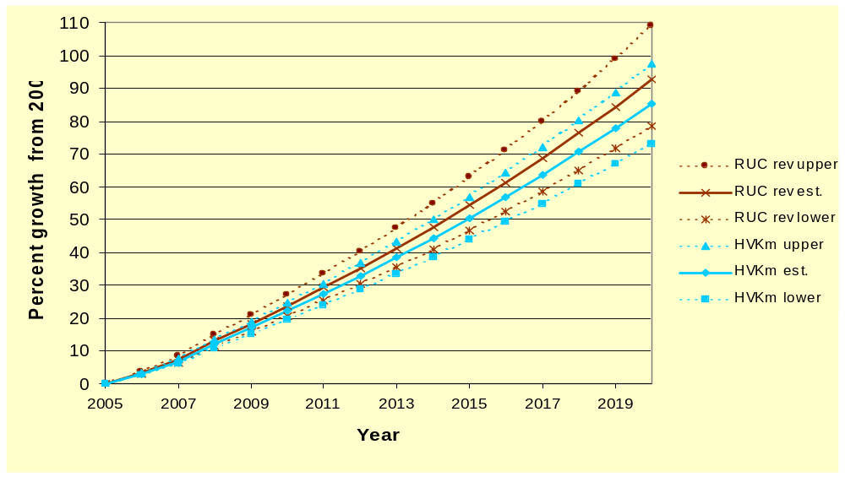
Forecast HMV km and RUC revenue growth 2005-2020
(Source: TERNZ)

Slide 12
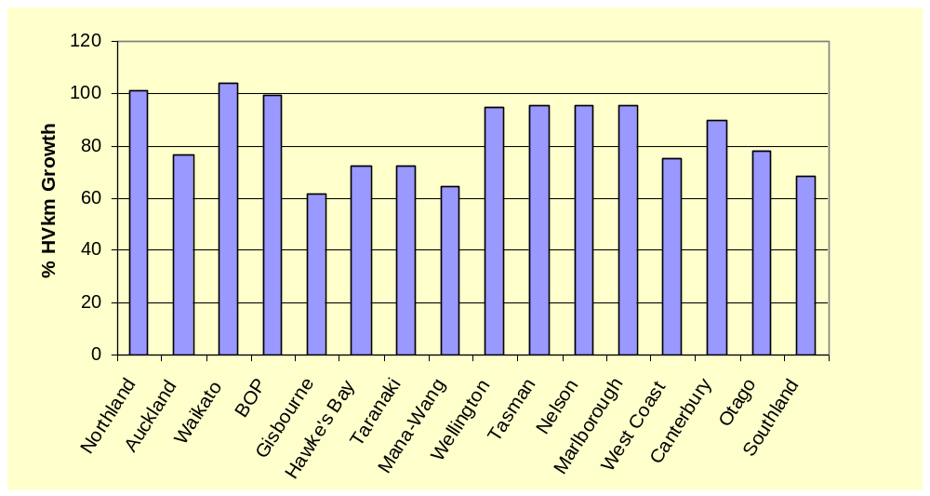
Forecast Regional heavy vehicle travel growth (HVkm) between 23005 and 2020
(Source: TERNZ)

Slide 13
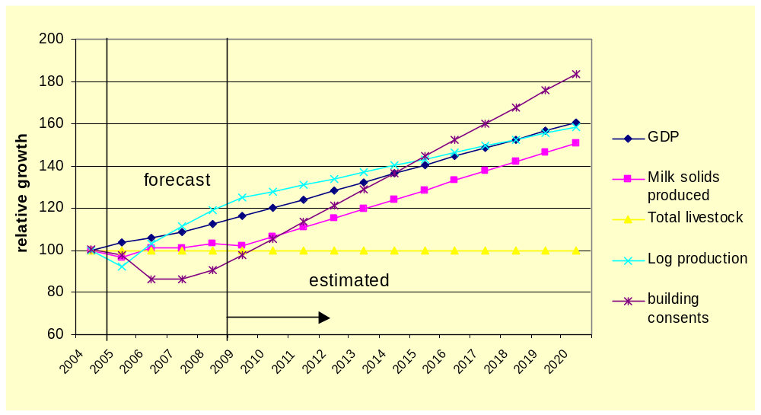
Forecast and estimated growth in New Zealand’s largest commodity groups and the construction industry between 2005 and 2020
(Source: TERNZ)

Slide 14
What impact will rail have (TERNZ)
Current market shares:
Road 83%
Rail 13%
Sea 4%
Rail’s potential market is 20%:
  42% between rail compatible regions
  30% no convenient access to rail
  30% time sensitive
Rail has an important role
  Don’t have unrealistic expectations
  Market share change is 2 years growth
  Coastal shipping policy may hit rail market

Slide 15
Variations from forecasts:
  GDP growth
  Regional growth
  Changes in economy (service/commodity)
  Road pricing
  Fuel costs
Forecasts may be conservative
Rail is unlikely to capture 100% of their potential contestable market (20%)

Slide 16
Conclusions
GDP growth and freight growth in New Zealand are strongly linked
Freight tonnages will grow by 72% to 109% from 2005 to 2020
Major growth will be in Auckland, Waikato, Bay of Plenty and Canterbury
Road freight will grow by at least the same rate
Policy, planning and investment levels are lagging behind

